Slide 1
Problem Statement/objectives
Problem Statement:
To convert static regular time based traffic system into a dynamic traffic density controlled based, using IR sensor.
Project Objectives:
Effective traffic management will lead to better utilization of transportation infrastructure.
Dynamic traffic signals in prime areas will reduce regular congestion, as result there will be less air pollution and increase in air quality.
Problems such as wastage of fuel, emergency case could be overcome through this proposed system. This system aims at saving a large amount of waiting hours caused by traffic deadlocks, where control can save time and property.

Slide 2
Existing Solutions/Literature Survey
Present conventional traffic system fails to provide traffic status about congested roads, alternate routes etc.
Traffic lights are commonly used devices to regulate roadway intersection traffic with a view to both safety and smoothness of vehicle flow, for generations where it is still considered the best practices.
The current traffic control systems (TCS) within the metro cities of India are inefficient due to randomness within the traffic density pattern throughout the day. The traffic light timers have a hard and fast period to modify traffic between different directions. Due to this, the vehicles need to wait an extended time albeit the traffic density is extremely less.
If the traffic light timer (TST) is often programmed to be manipulated with the continuously varying traffic density, the matter of traffic jam can be often reduced to a significantly lower level.

Slide 3
Proposed solution
The main aim of this solution is to convert current static time based traffic system into a vehicle density based smart traffic system.
We are using IR sensors to sense the obstacle from vehicles.
On each road of intersection , sensors will be planted , for sensing traffic.
If the traffic is more than the specified road limit , then an additional time of green signal must be given to that particular lane of intersection.
Also , the system is connected to IOT platform , on which a facility of green-corridor buttons for respective lanes is given , activating which will lead to green signal on that lane till the button is set off.

Slide 4
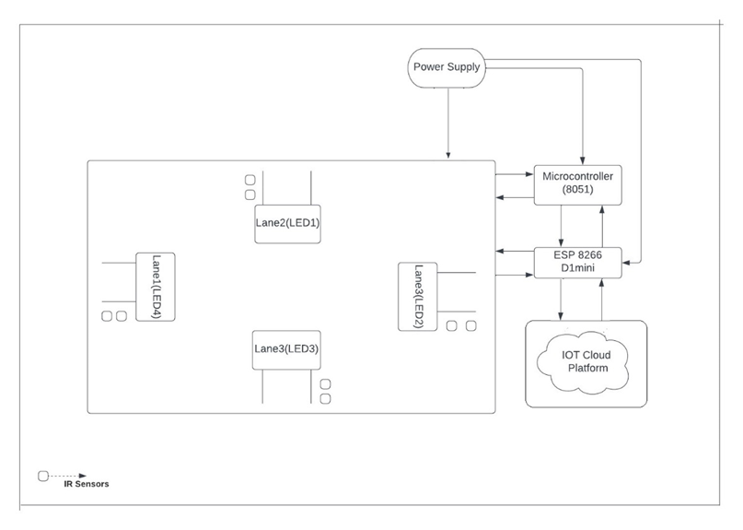
Block Diagram

Slide 5
Description of Block Diagram
As shown in the Block Diagram on each lane a has a sensor planted, the purpose of sensor is to collect data related to traffic density.
The lights in each lane and the sensor belonging to respective lanes are all connected to several parts of microcontroller 8051.
The 8051 microcontroller is connected to a development board called as wemos D1 mini, which has a built-in ESP8266 wifi-module, and operates on a clock speed of 80Mhz/160Mhz.
The power supply circuit is present which aims in providing required voltage to all the respective blocks as per their requirements.
The development board D1 mini is integrated with the IOT cloud platform for monitoring and controlling purposes.

Slide 6
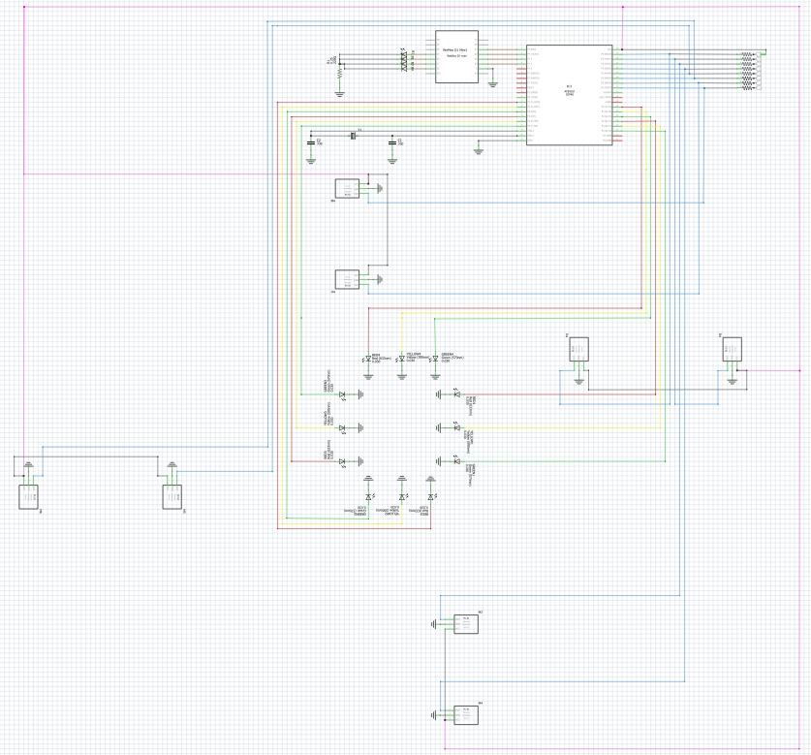
Circuit Diagram And Its Working

Slide 7
Important Points On Circuit Diagram
Each lane has an IR sensors planted on them.
The port 0 of the 8051 is connected to the IR sensor output pins.
Port 2 and Port 3 pins of 8051 micro controller are occupied by 12 leds from all the FOUR lanes.
The four pins of port 1 i.e P1.0 , P1.1 , P1.2 , P1.3 , are connected to D1 , D2 , D3 , D4 pins of Wemos D1-mini development board respectively.
The job of these four connections is to activate the emergency signal which will be sent to these four pins to activate the emergency green signal in the respective signals.
D5 , D6 , D7 , D8 pins of Wemos D1-mini are connected to Blue LEDs respectively.
A crystal of frequency 11.059-MHz is connected to Xtal-1 & Xtal-2 pins of 8051, along with capacitors , to provide it clock speed.

Slide 8
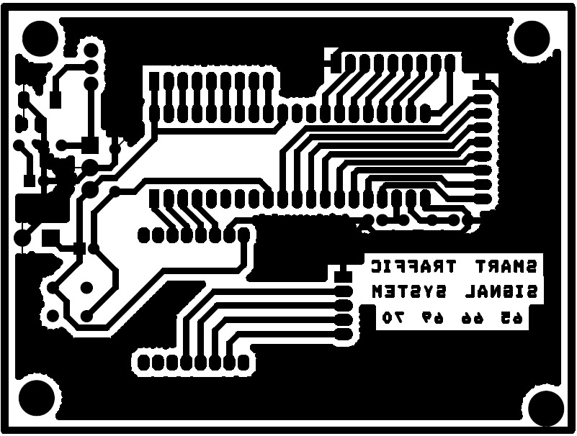
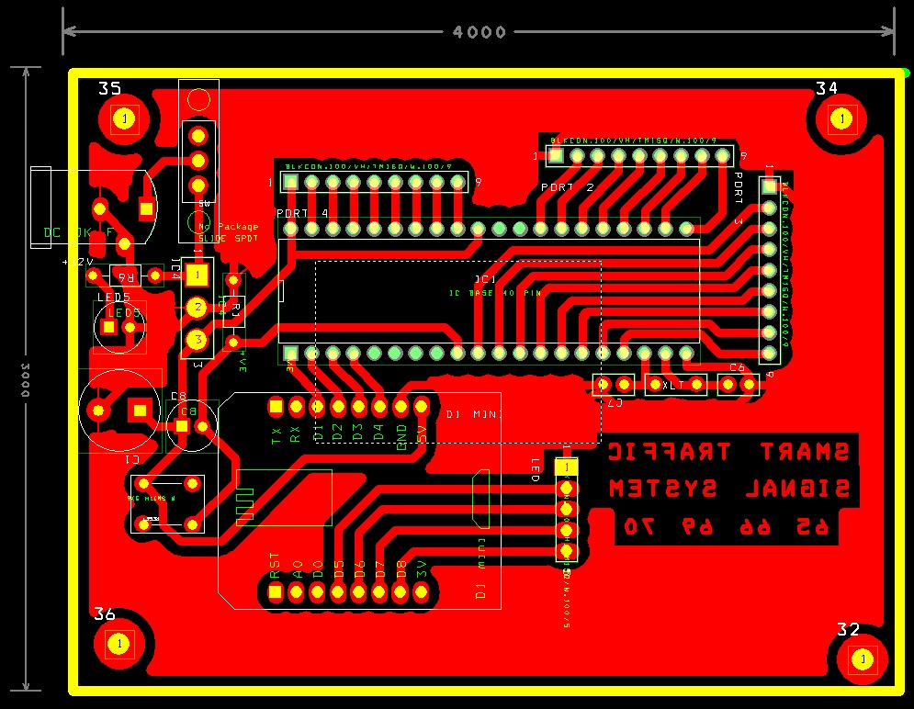
PCB design

Slide 9
Important Points on PCB Design and Art Work
As we can observe from the diagram above , the final size of PCB is approximately around 4-Inches x 3-Inches.
In the left hand side of the design , the provision for DC-female jack , IC-7805 , Resistors & Capacitors is given.
The circuit on the left side of design is implemented to step-down the input of 9-volts to 5-volts , or else extra power supply can lead to damage of components.
Then a copper track is given to supply 5-volts to Vcc pins of 8051 and D-mini respectively.
In Port-0 , Port-1 , Port-2 & Port-3 of 8051 , footprints for ports is given , for wire connection.
Similarly , the ports are assigned to the pins of D1-mini for wire connection.
The PCB design is efficient and compact for the circuit implementation.

Slide 10
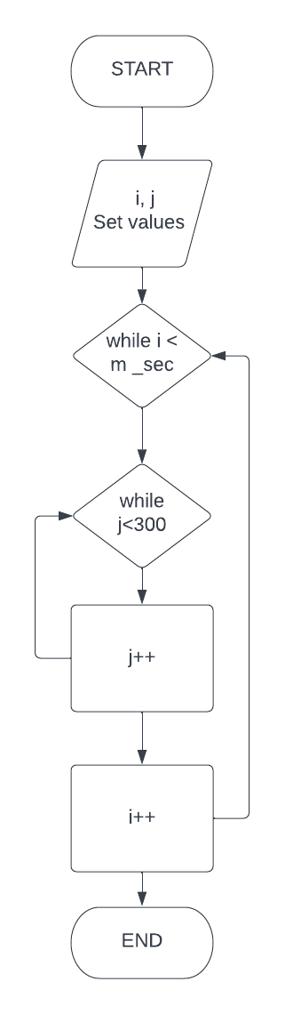
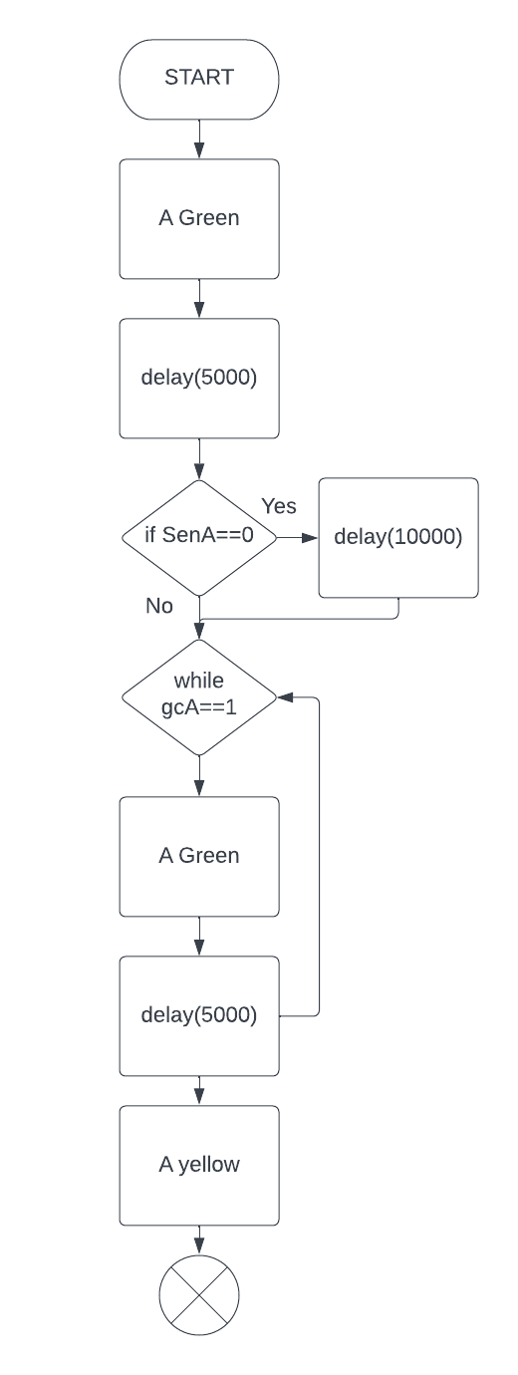
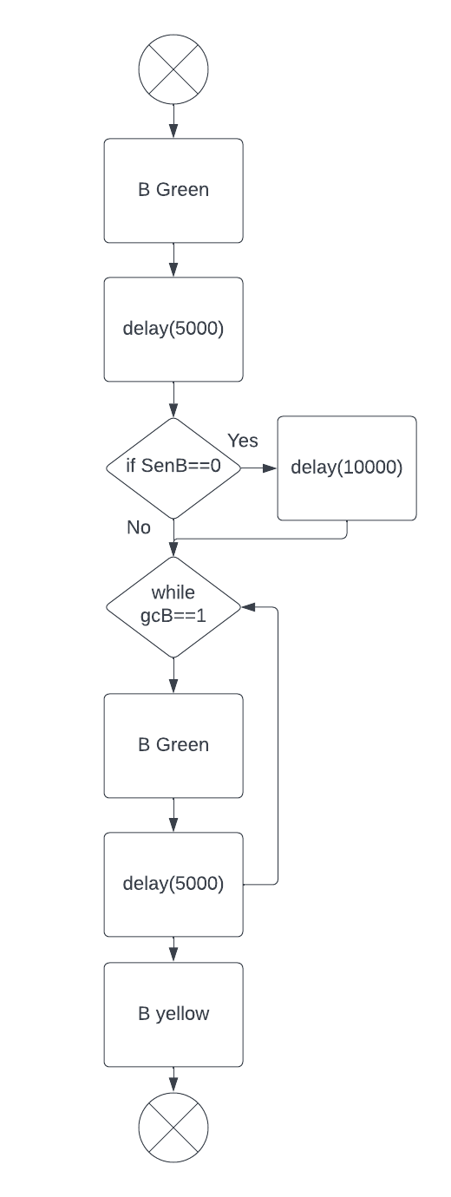
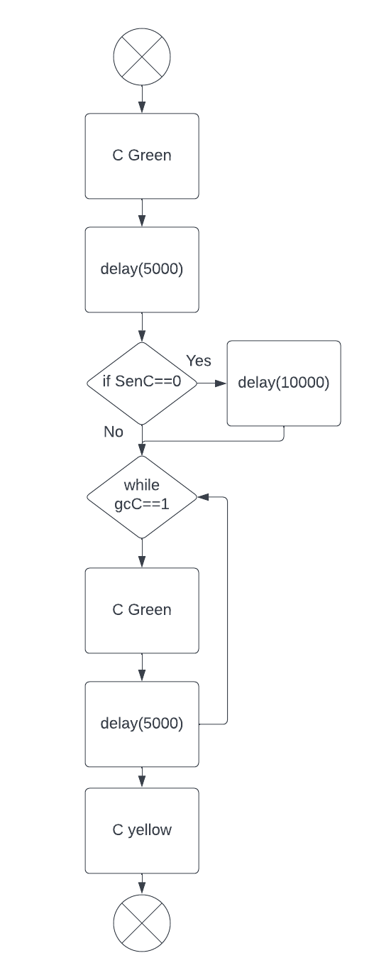
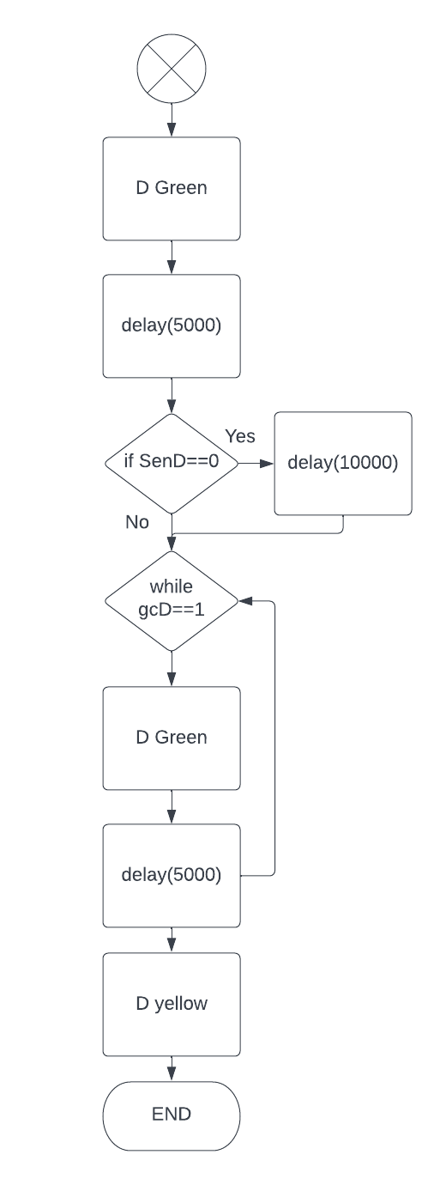
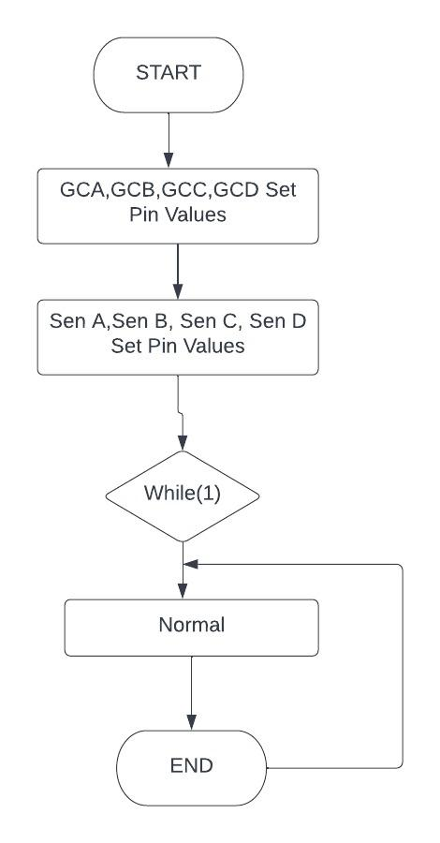
Flowchart for 8051

Slide 11
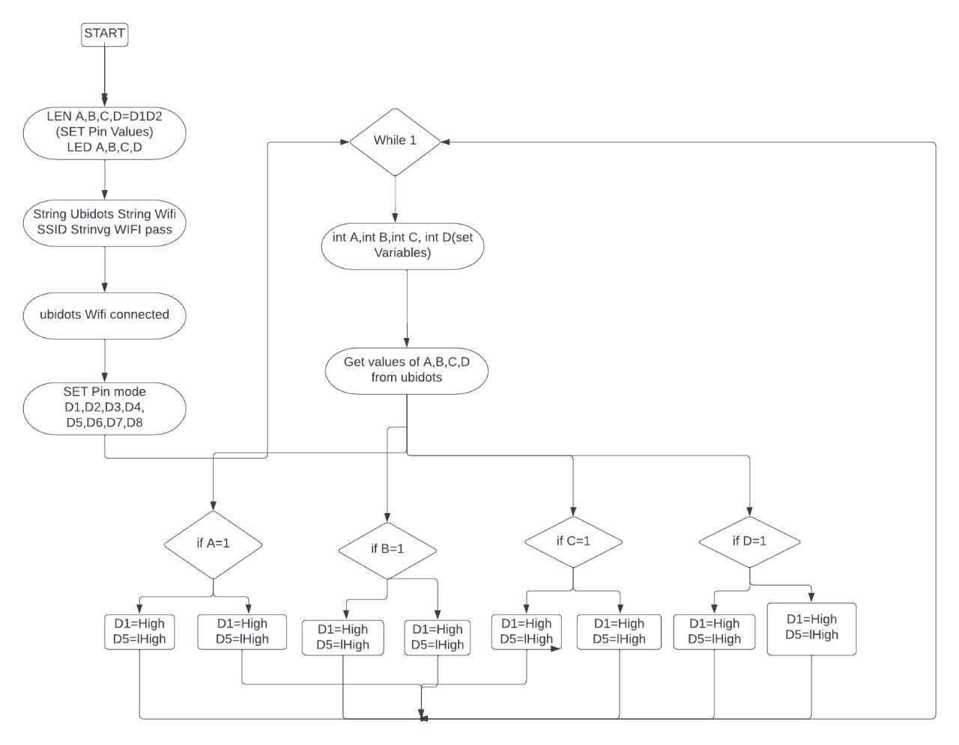
Flowchart for D1-Mini

Slide 12
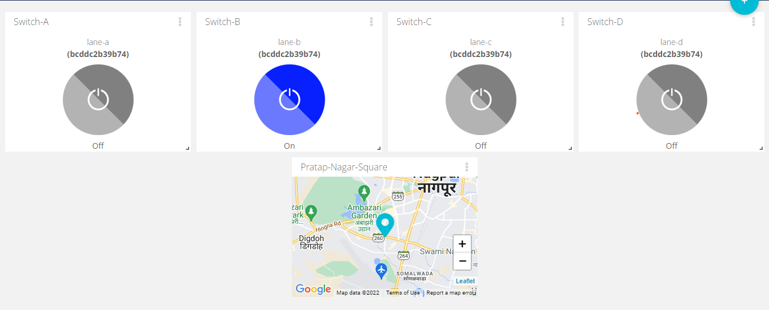
IOT Interface : (UBIDOTS)

Slide 13
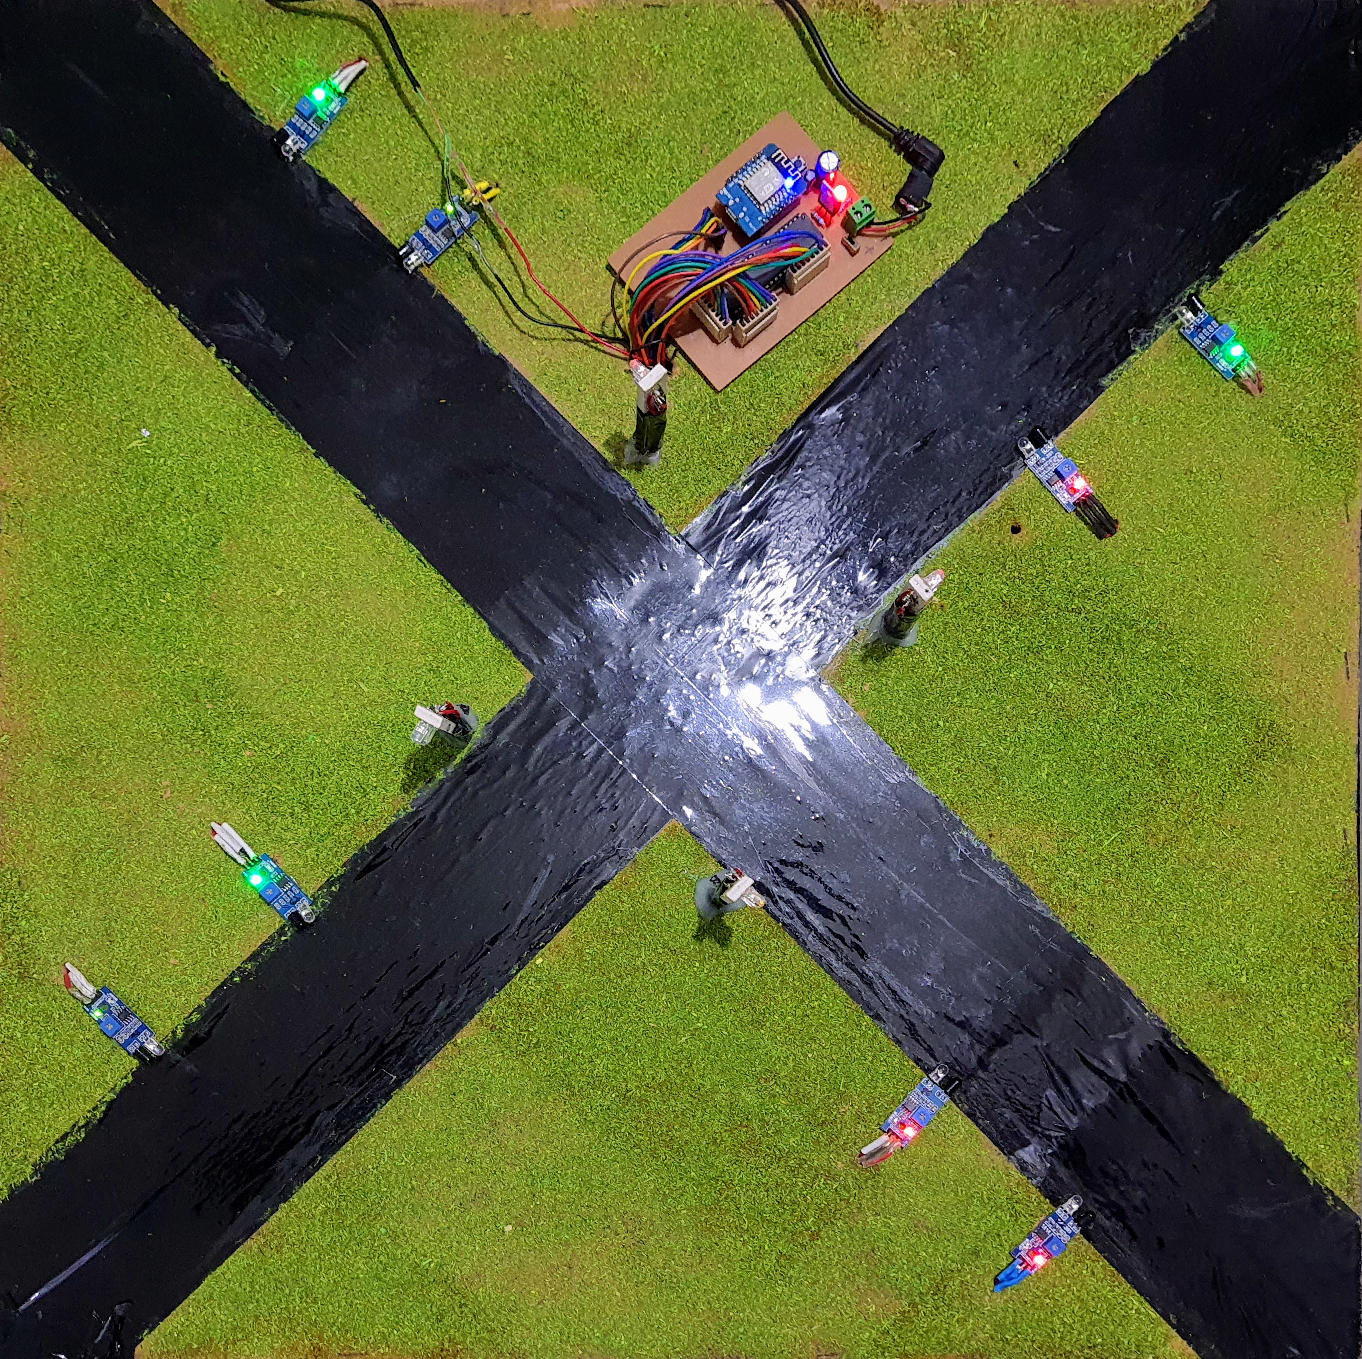
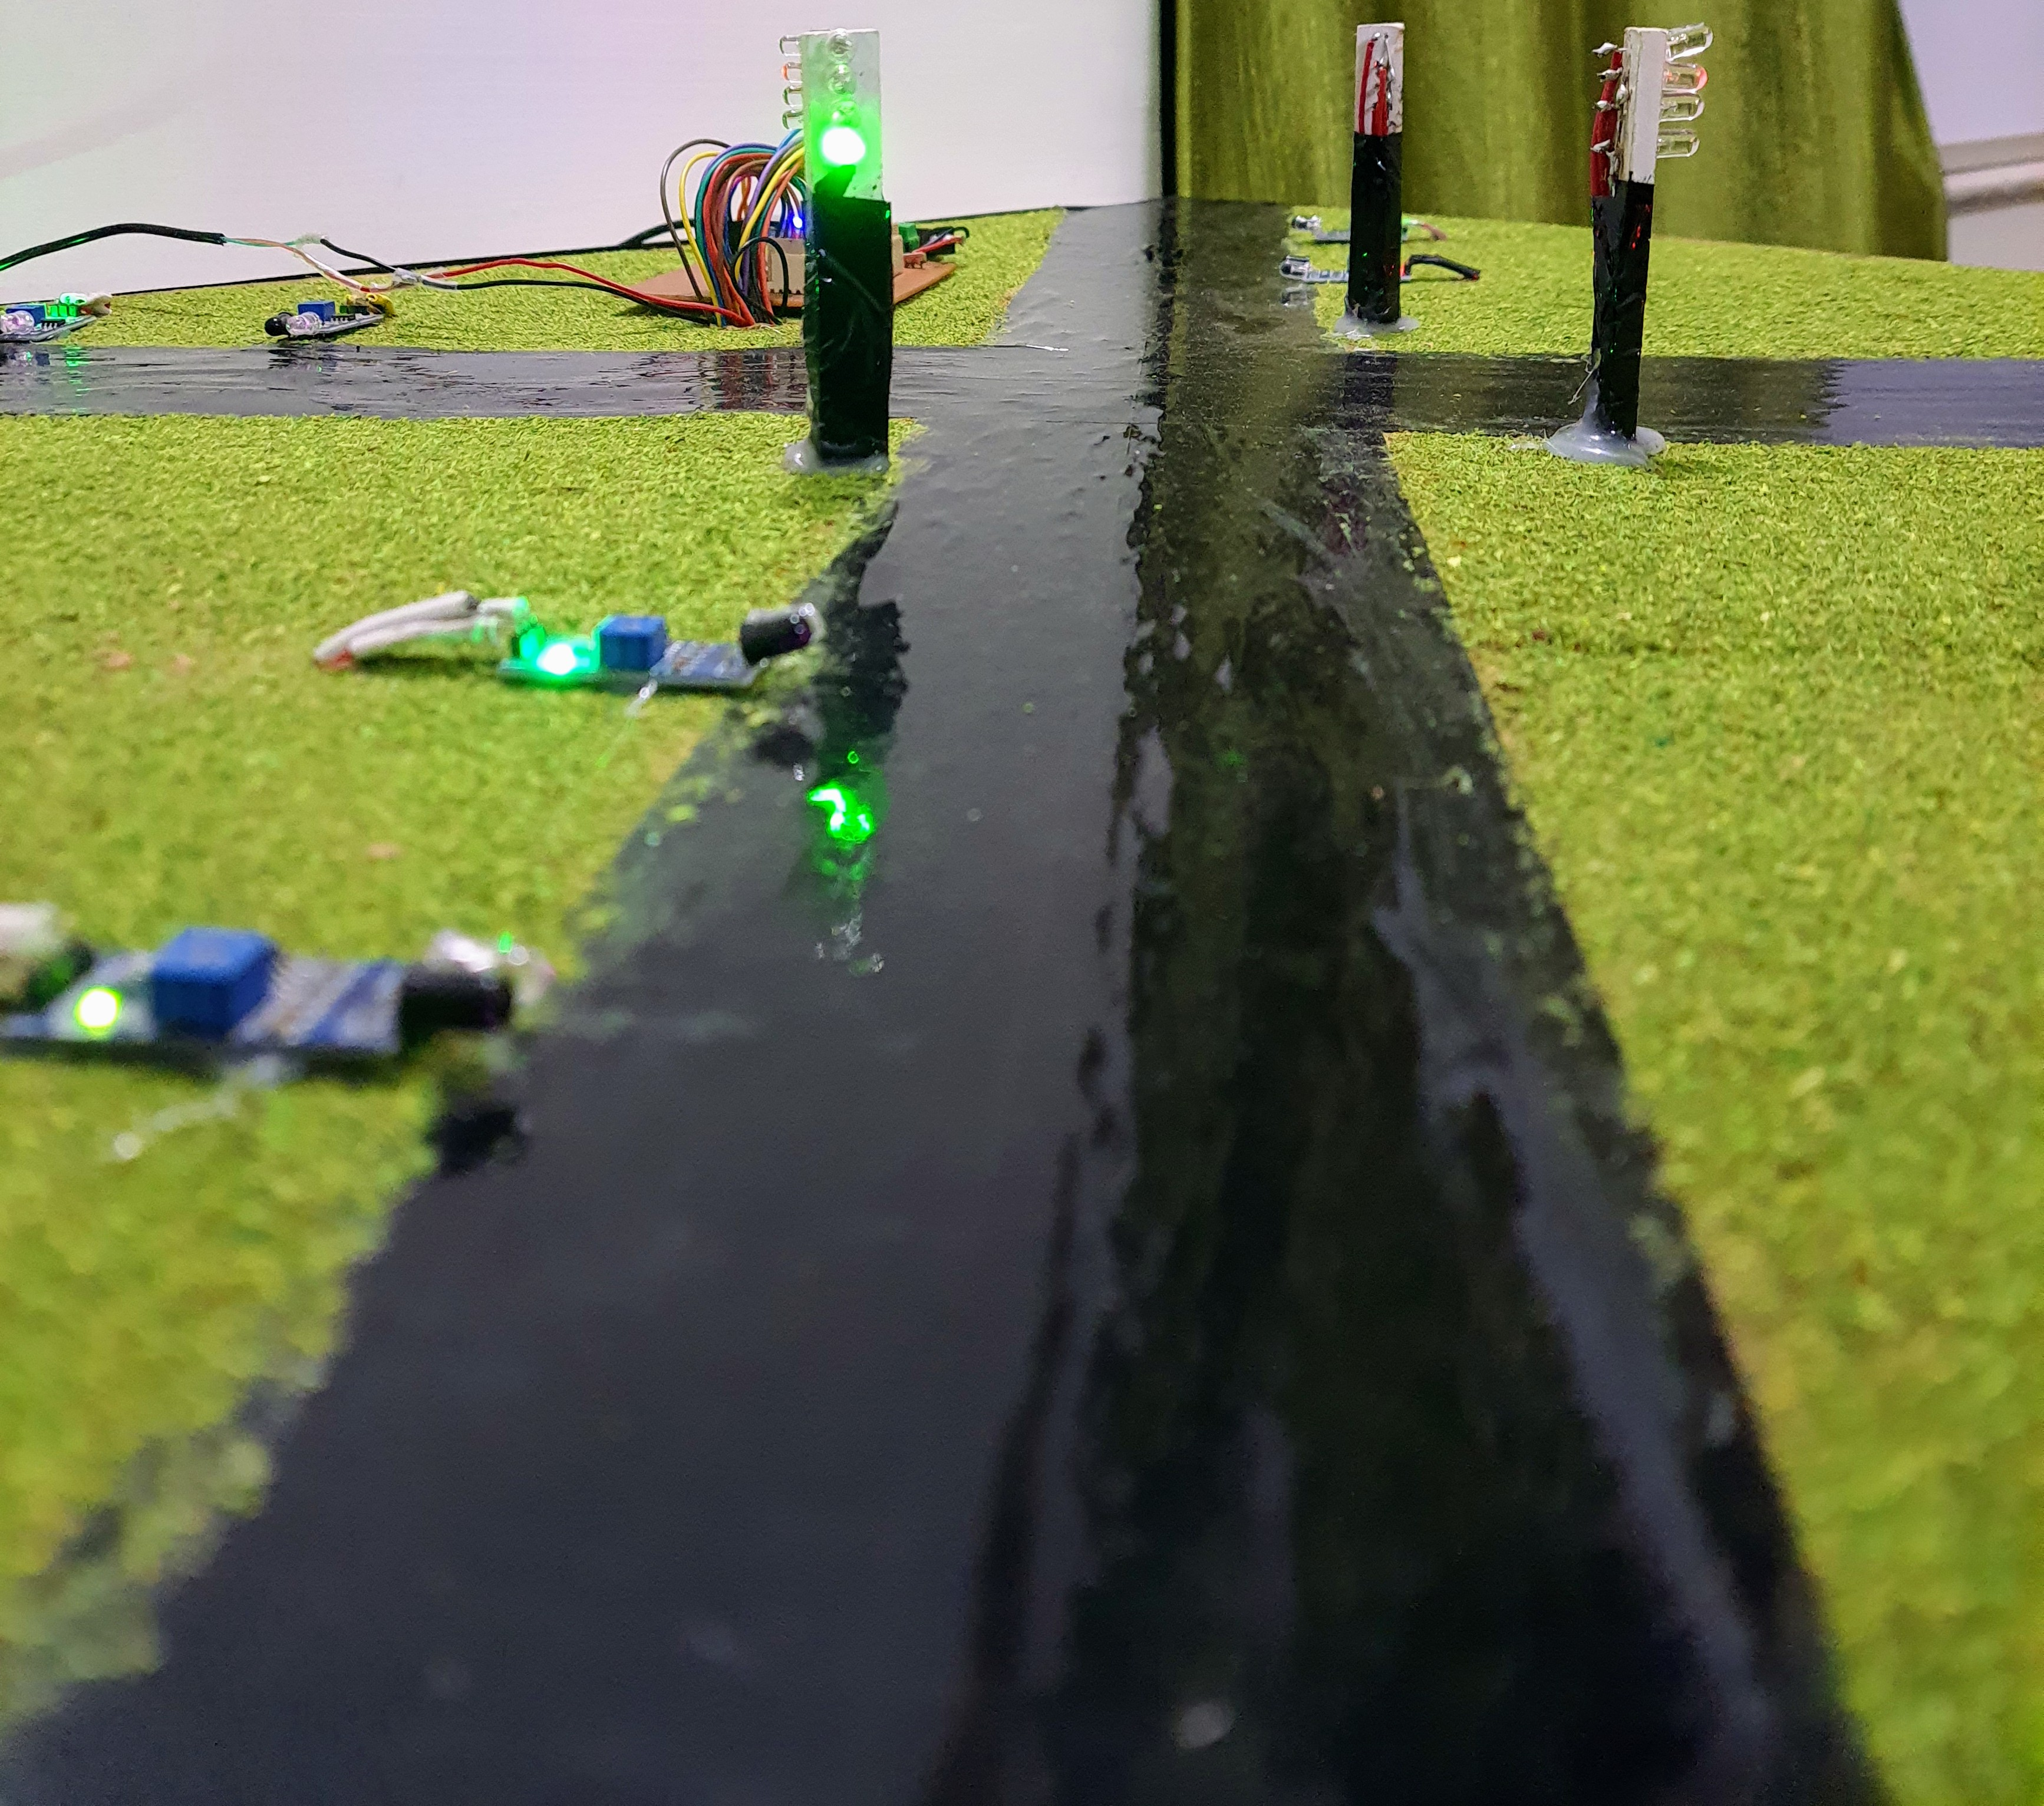
Result
The circuit designed is running successfully and is showing the desired output.
The code implementation is perfect and is giving result as per the requirements along with IOT override for green corridor (emergency).
If the traffic (obstacle) is sensed by the sensor at a particular lane , then immediately a delay for extra time in green signal is observed for that road.

Slide 14
Feasibility Analysis
The design of the model for the proposed idea is feasible and easy to implement , in practical scenarios.
The choice of using an 8051 micro-controller is giving us an advantage because of plenty of available pins for input/output operations.
Similarly , using a Wemos-D1 mini proves to be wise decision as it is less costly than other ESP8266 category devices and is fluently able to interface with the IOT dashboard created.
Still , a handful number of pins are still available in Wemos D1-mini as well as 8051 , in-case of further addition to the design/model , giving us an additional convenience.
However , as far as implementing the IR sensors is considered , instead of using an integrated (combined) transmitter-receiver module , we must use separate IR transmitters & receivers , which then are needed to be planted on the both sides on the lane/road and further R&D is required on it.
Also , if we need to plant more sensors on a particular road further , then additional decoder must be applied at the desired port of 8051.
The design & model is cost effective and easy to implement.

Slide 15
Innovation or Uniqueness of the solution
At certain junctions even if there is no traffic when the traffic light remains red the road users have to wait until the light turns green and if rule is broken fine has to be paid. But our system works on traffic density and if one lane has no traffic, it turns green for the next lane
Emergency signal in the system to clear the lane with ambulance first.
Simple circuit with 8051 microcontroller, D1 mini ESP8266 module and sensors.
During traffic jam an emergency vehicle like ambulance, fire brigade, police are stuck and have to wait for the traffic light to turn green. Hence this critical problem may further complicate that costs human life. So solution to this problem can be given by having priority for emergency vehicle to flow rapidly through the traffic while other vehicles are instructed to be still.

Slide 16
Impact or Usefulness of the solution
Provides effective traffic management.
By enhancing the flow of traffic it will reduce the regular congestion in the prime area. This means less waiting time at intersection and lower emissions which ultimately lead to less air pollution and save fuel.
During traffic jam an emergency vehicle like ambulance, fire brigade, police are stuck and have to wait for the traffic light to turn green. Hence this critical problem may further complicate that costs human life. This system provides an emergency signal in the lane with ambulance will be cleared first.
Helps in minimizing the accidents by easing the flow of traffic.

Slide 17
Summary
The system is designed to be robust, reliable, and cost effective.
The system uses sensors mounted on traffic signals to detect the precise arrival-time of vehicles at stop signs and as per the traffic on the lane, yielding precise advisory control over traffic signal intensities without any physical modification to existing roadway infrastructure.
The system can provide green corridor to emergency vehicles with effective traffic management.
This project aims at controlling the traffic light based on vehicle density rather than providing a fixed time to each.

Slide 18
References
Ghazal, Bilal, et al. "Smart traffic light control system." 2016 third international conference on electrical, electronics, computer engineering and their applications (EECEA). IEEE, 2016.
Díaz, Nicole, Jorge Guerra, and Juan Nicola. "Smart traffic light control system." 2018 IEEE Third Ecuador Technical Chapters Meeting (ETCM). IEEE, 2018.
Hilmani, Adil, Abderrahim Maizate, and Larbi Hassouni. "Automated real-time intelligent traffic control system for smart cities using wireless sensor networks." Wireless Communications and Mobile Computing 2020 (2020).
Megalingam, Rajesh Kannan, et al. "Smart traffic controller using wireless sensor network for dynamic traffic routing and over speed detection." 2011 IEEE Global Humanitarian Technology Conference. IEEE, 2011.

Slide 19
links
https://www.researchgate.net/publication/305674408_Smart_traffic_light_control_system
https://ieeexplore.ieee.org/document/7470780
https://www.hindawi.com/journals/wcmc/2020/8841893/
https://www.ijert.org/smart-traffic-light-system-with-over-speed-detection
https://www.ijrte.org/wp-content/uploads/papers/v8i6/F7533038620.pdf

Slide 20


